Slide 1
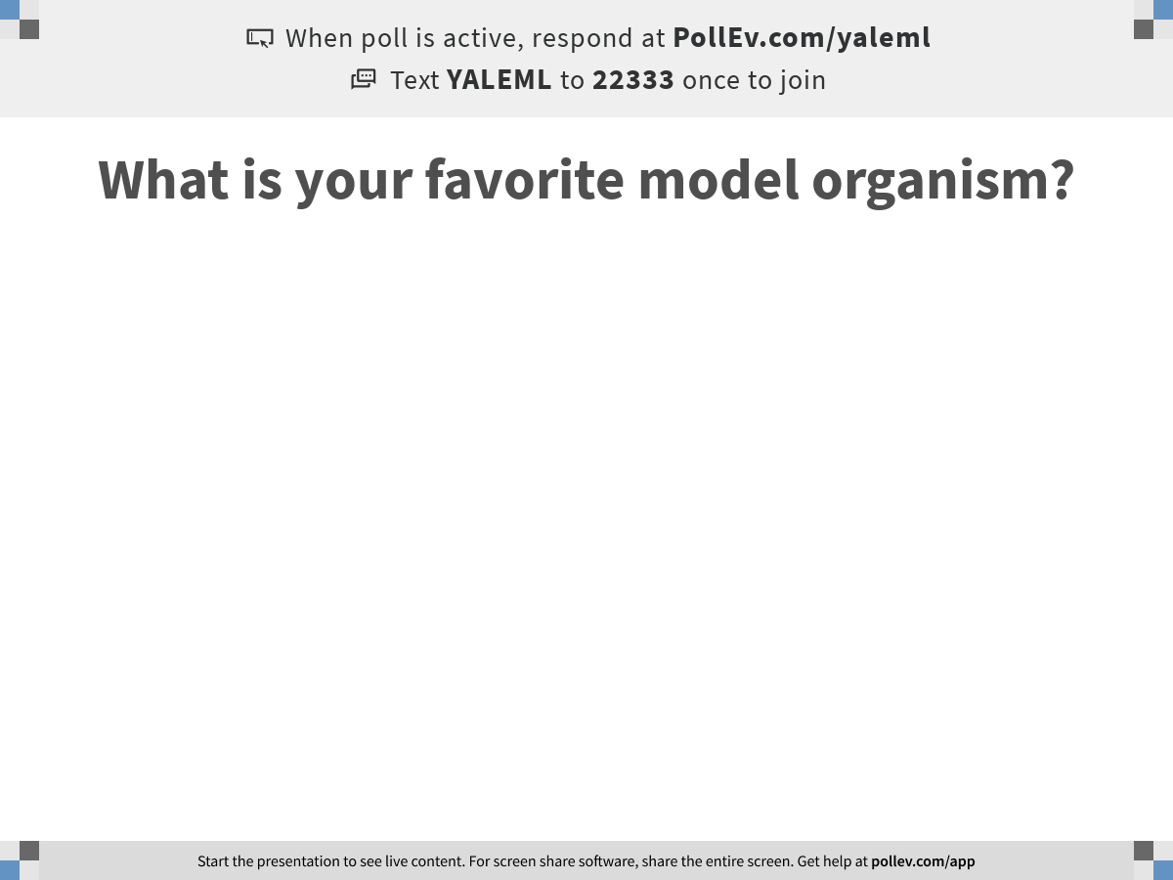
Notes:
What is your favorite model organism?
https://www.polleverywhere.com/free_text_polls/bi9MJ5vC17sTijM4RmagV

Slide 2

Machine Learning for Single Cell Analysis
Course introduction
Notes:
TA introduction
Talk about not teaching code (not a programming workshop)

Slide 3

https://krishnaswamylab.org/get-help

Slide 4
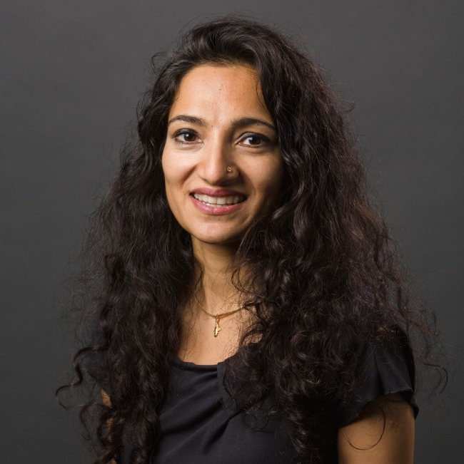
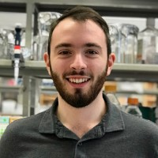





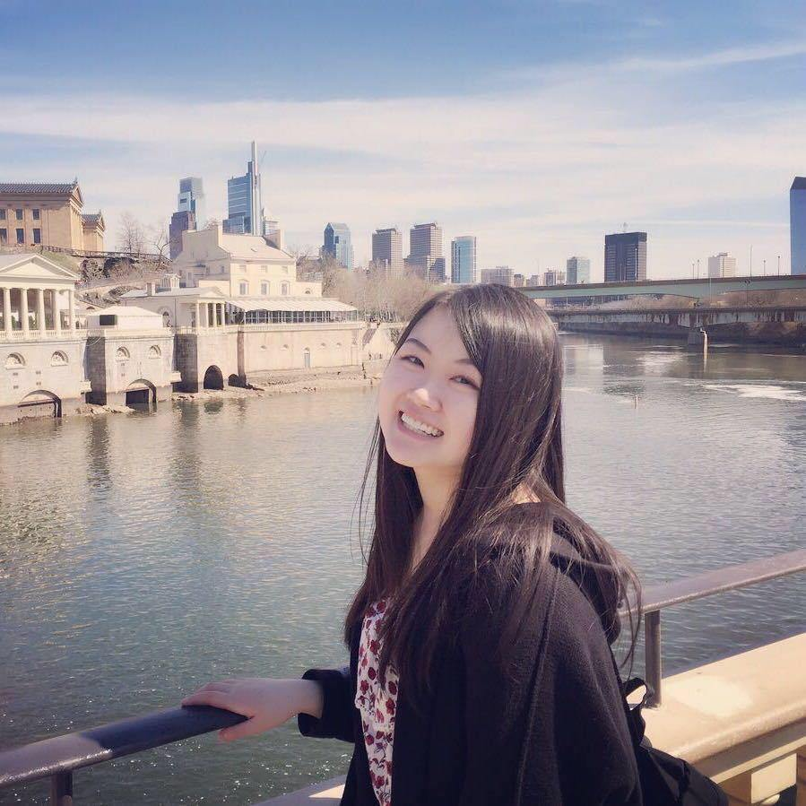
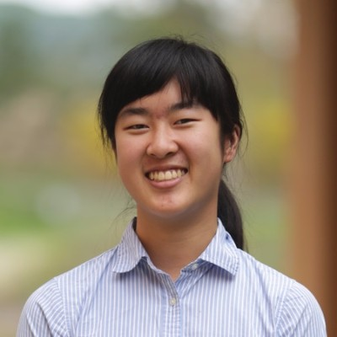
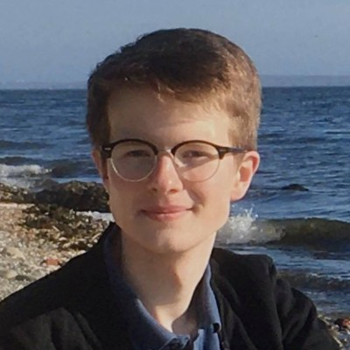

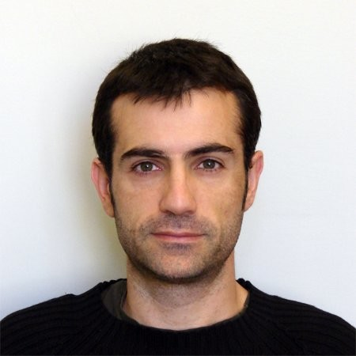
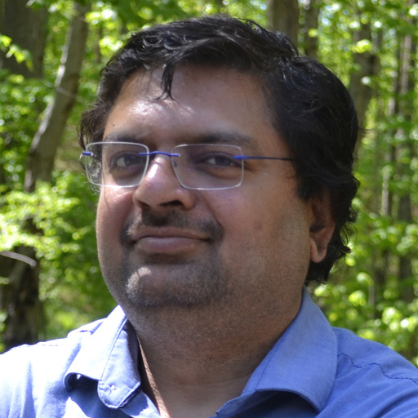
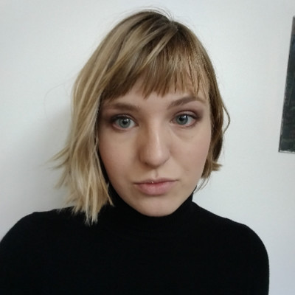

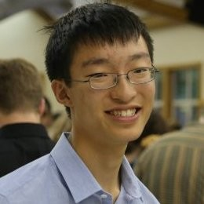
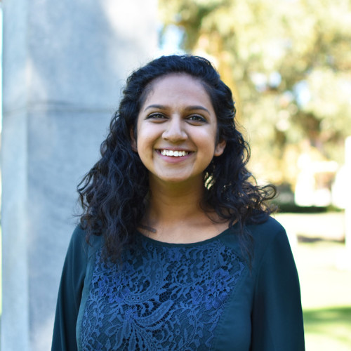
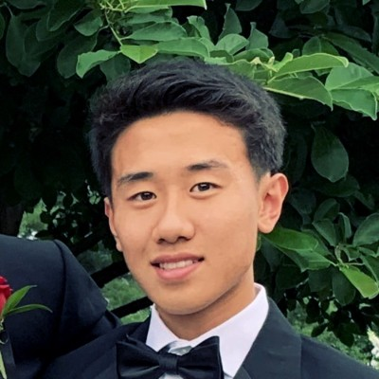

Smita Krishnaswamy
Scott Gigante
Kofi Ansong
Andrew Benz
Daniel Burkhardt
Egbert Castro
Pranik Chainani
Joanna Chen
Annie Gao
Michał Gerasimiuk
Wes Lewis
Francesc Lopez
Sameet Mehta
Sasha Safonova
Giacomo Scanavini
Alexander Tong
Aarthi Venkat
Max Yuan
Jeffrey Zhou
Giacomo Scanavini

Slide 5
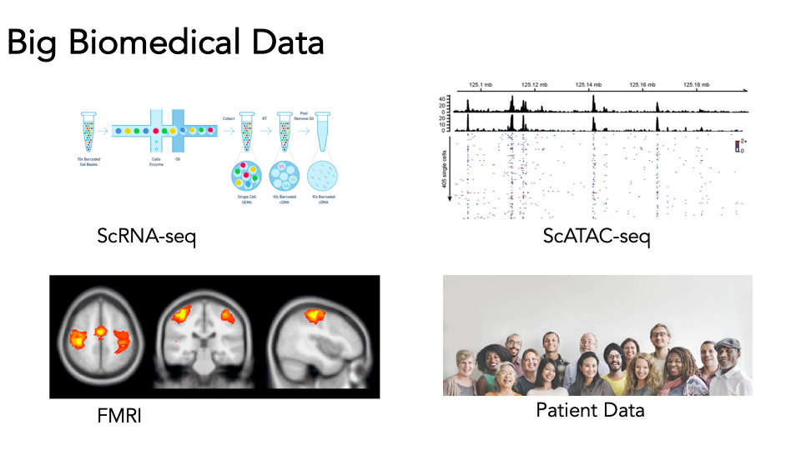
Big biomedical data
Big = Any dataset with many many observations

Slide 6
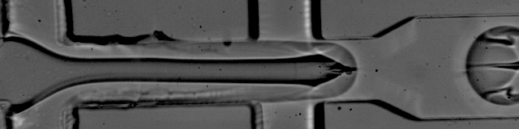
The single cell revolution
Beads
Lysis buffer
Data
Cells
Oil
http://mccarrolllab.org/dropseq/

Slide 7
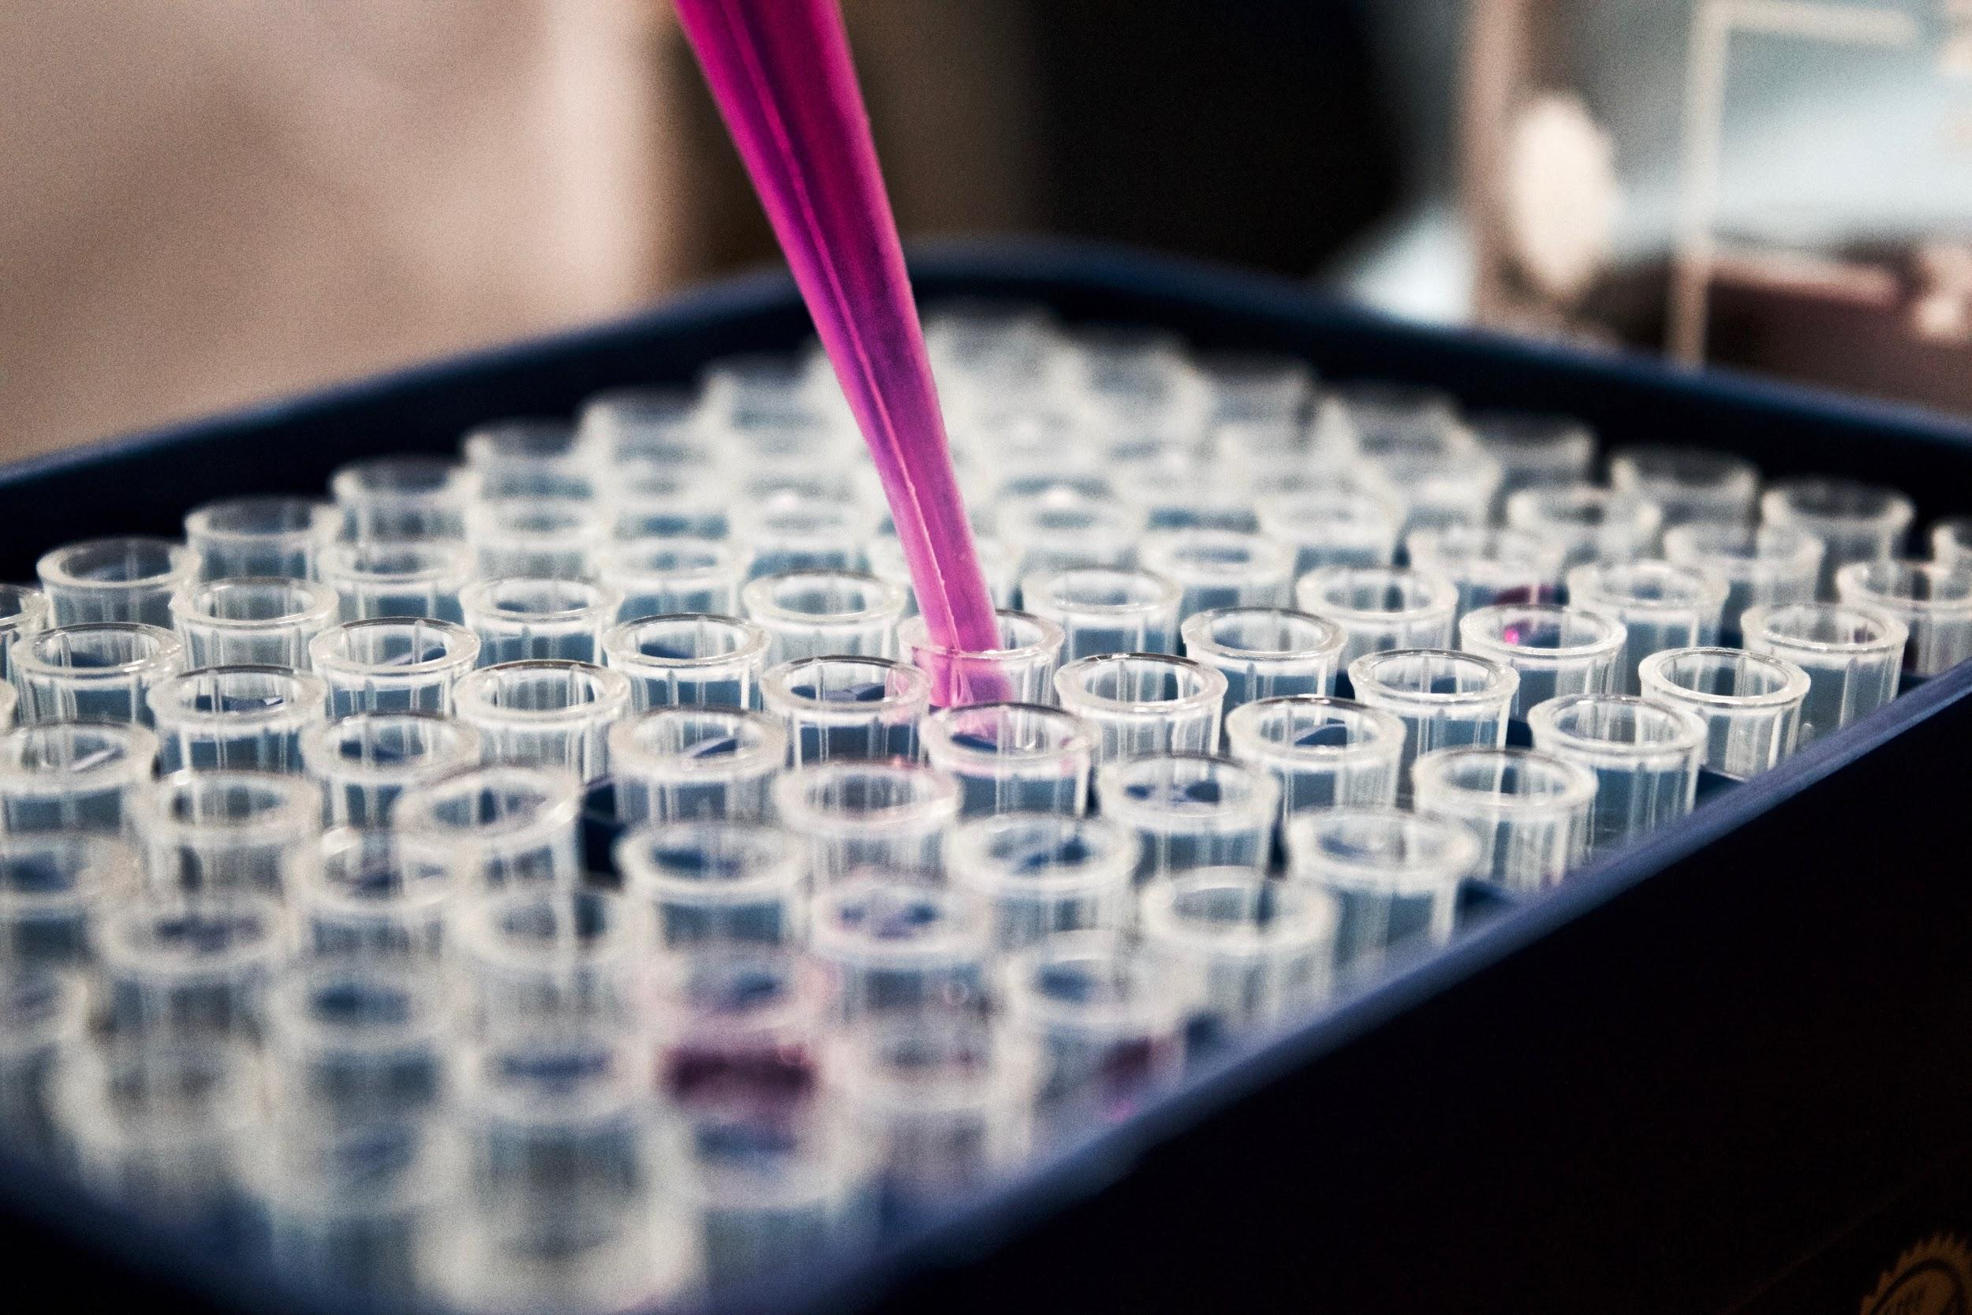

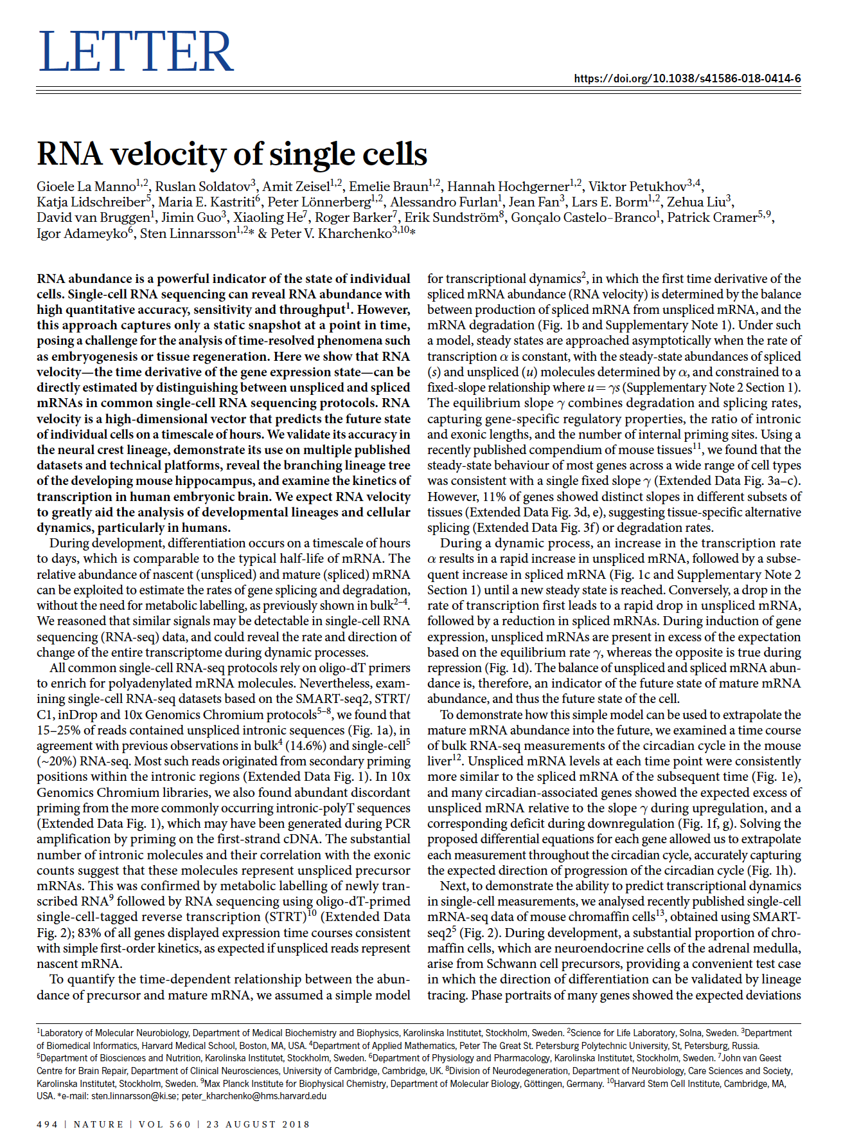
The single cell revolution
Interesting Biological Experiments
Computation
High impact paper

Slide 8
The single cell revolution
Interesting Biological Experiments
Computation
High impact paper
Machine learning
Linear algebra
Probability theory
Statistical analysis
Algorithm design

Slide 9
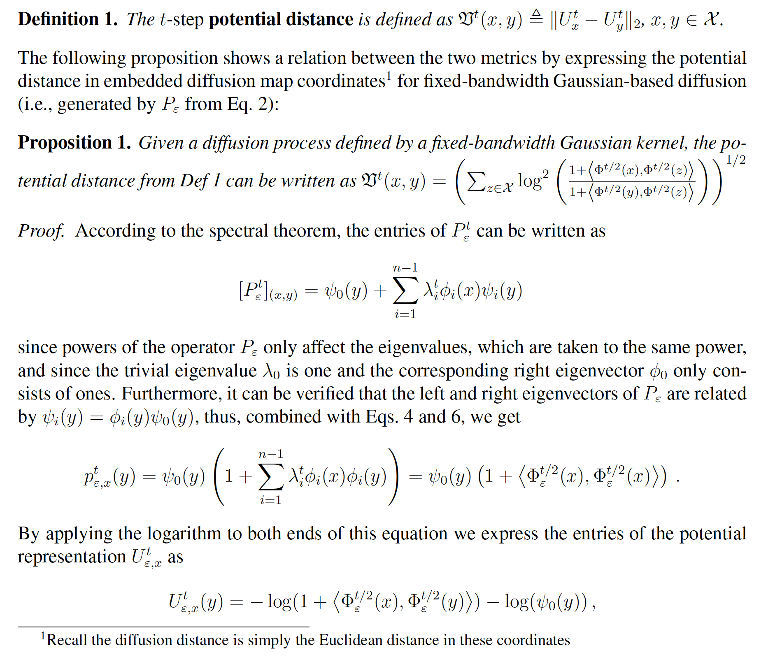
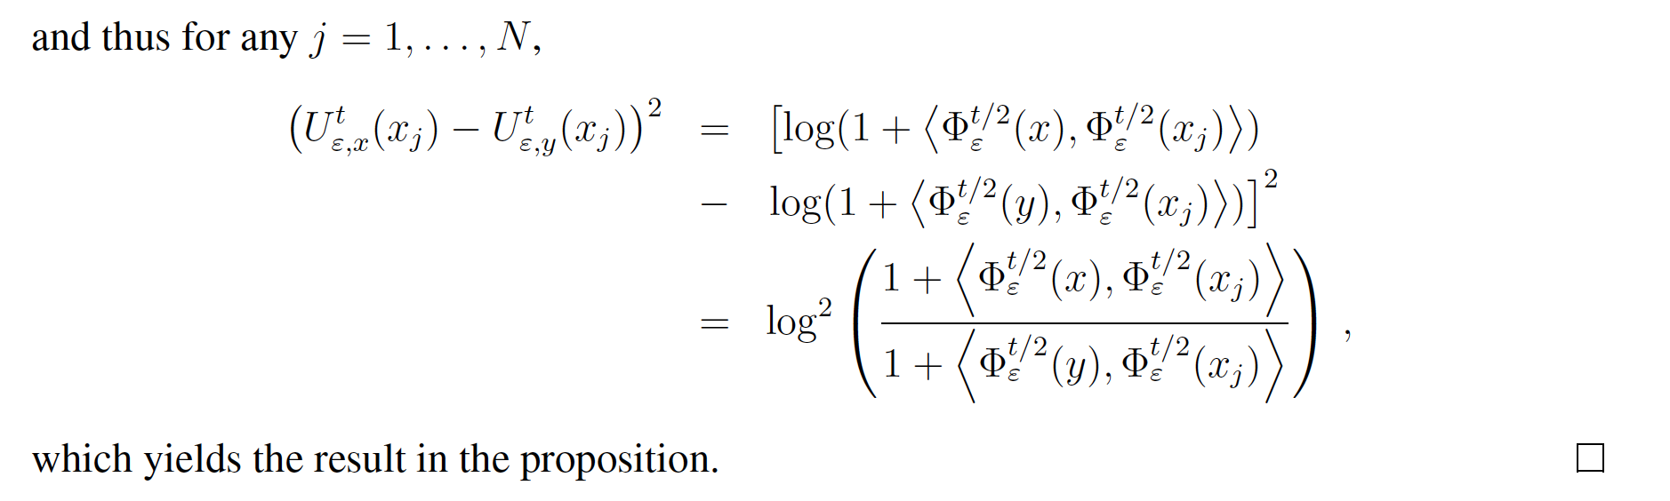
It’s all Greek to me...
Moon et al. (2019)

Slide 10

What reading single cell methods can feel like

Slide 11
What is machine learning?

Slide 12
What is machine learning?
Machine learning is the process of identifying patterns in data.

Slide 13

Two kinds of machine learning
Supervised learning
Have a bunch of labelled data, want to label new data

Slide 14


Two kinds of machine learning
Supervised learning
Have a bunch of labelled data, want to label new data
Supervised Learning Model
Noun project

Slide 15
Two kinds of machine learning
Supervised learning
Have a bunch of labelled data, want to label new data
Supervised Learning Model
Strawberry!
Noun project

Slide 16
Two kinds of machine learning
Supervised learning
Have a bunch of labelled data, want to label new data
Supervised Learning Model
Noun project

Slide 17
Two kinds of machine learning
Supervised learning
Have a bunch of labelled data, want to label new data
Supervised Learning Model
Banana
Noun project

Slide 18
Two kinds of machine learning
Supervised learning
Have a bunch of labelled data, want to label new data
Supervised Learning Model
Noun project

Slide 19
Two kinds of machine learning
Supervised learning
Have a bunch of labelled data, want to label new data
Supervised Learning Model
Strawberry!
Noun project

Slide 20
Two kinds of machine learning
Supervised learning
Have a bunch of labelled data, want to label new data
Supervised Learning Model
Noun project

Slide 21
Two kinds of machine learning
Supervised learning
Have a bunch of labelled data, want to label new data
Supervised Learning Model
?
Noun project

Slide 22
Two kinds of machine learning
Supervised learning
Have a bunch of labelled data, want to label new data
Supervised Learning Model
Strawberry!
Noun project

Slide 23



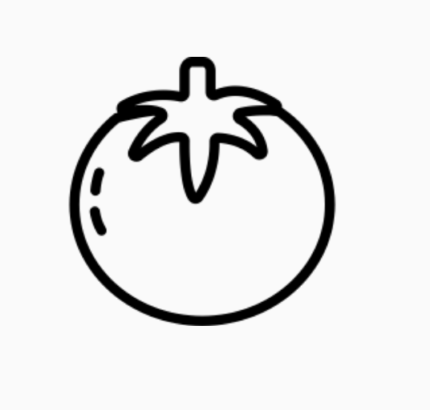

Two kinds of machine learning
Supervised learning
Have a bunch of labelled data, want to label new data
Unsupervised learning
Have a bunch of unlabeled data, want to organize it
Supervised Learning Model
Unsupervised Learning Model
Strawberry
Noun project
Notes:
Differentiate between supervised and unsupervised learning, left figure should have the label strawberry as output, right figure should also just have one image but it should have maybe a couple of vectors (of numbers) as output

Slide 24
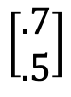
Two kinds of machine learning
Supervised learning
Have a bunch of labelled data, want to label new data
Unsupervised learning
Have a bunch of unlabeled data, want to organize it
Supervised Learning Model
Unsupervised Learning Model
Strawberry
$$\left[\begin{matrix}.7 \\ .5\end{matrix}\right]$$
Noun project
Notes:
Differentiate between supervised and unsupervised learning, left figure should have the label strawberry as output, right figure should also just have one image but it should have maybe a couple of vectors (of numbers) as output

Slide 25
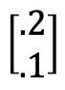
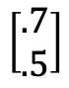
Two kinds of machine learning
Supervised learning
Have a bunch of labelled data, want to label new data
Unsupervised learning
Have a bunch of unlabeled data, want to organize it
Supervised Learning Model
Unsupervised Learning Model
Strawberry
$$\left[\begin{aligned}.2 \\ .1\end{aligned}\right]$$
$$\left[\begin{aligned}.7 \\ .5\end{aligned}\right]$$
Noun project
Notes:
Differentiate between supervised and unsupervised learning, left figure should have the label strawberry as output, right figure should also just have one image but it should have maybe a couple of vectors (of numbers) as output

Slide 26
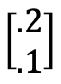
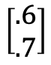
Two kinds of machine learning
Supervised learning
Have a bunch of labelled data, want to label new data
Unsupervised learning
Have a bunch of unlabeled data, want to organize it
Supervised Learning Model
Unsupervised Learning Model
$$\left[\begin{aligned}.2 \\ .1\end{aligned}\right]$$
Strawberry
$$\left[\begin{aligned}.6 \\ .7\end{aligned}\right]$$
$$\left[\begin{aligned}.7 \\ .5\end{aligned}\right]$$
Noun project
Notes:
Differentiate between supervised and unsupervised learning, left figure should have the label strawberry as output, right figure should also just have one image but it should have maybe a couple of vectors (of numbers) as output

Slide 27
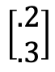
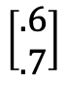
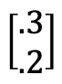
Two kinds of machine learning
Supervised learning
Have a bunch of labelled data, want to label new data
Unsupervised learning
Have a bunch of unlabeled data, want to organize it
Supervised Learning Model
Unsupervised Learning Model
$$\left[\begin{aligned}.3 \\ .2\end{aligned}\right]$$
$$\left[\begin{aligned}.2 \\ .1\end{aligned}\right]$$
$$\left[\begin{aligned}.2 \\ .3\end{aligned}\right]$$
Strawberry
$$\left[\begin{aligned}.7 \\ .5\end{aligned}\right]$$
$$\left[\begin{aligned}.6 \\ .7\end{aligned}\right]$$
Noun project
Notes:
Differentiate between supervised and unsupervised learning, left figure should have the label strawberry as output, right figure should also just have one image but it should have maybe a couple of vectors (of numbers) as output

Slide 28
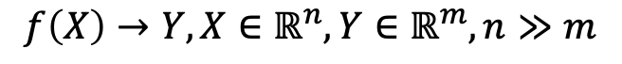
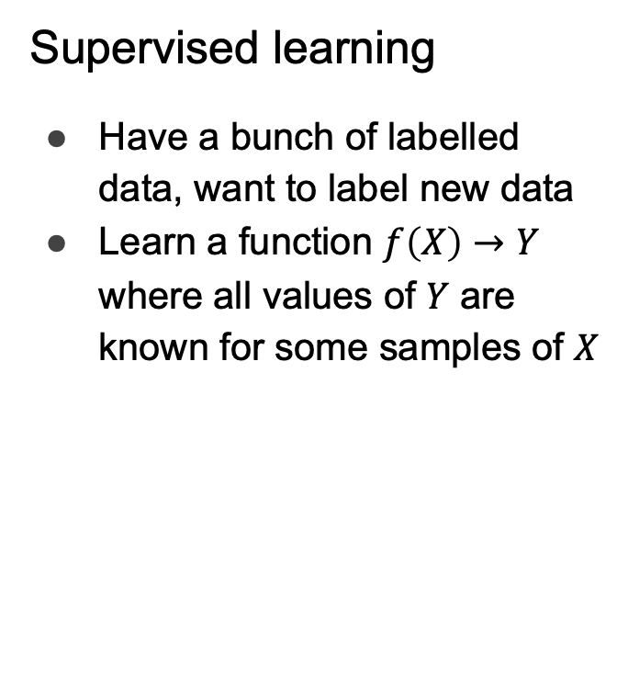
Two kinds of machine learning
Supervised learning
Have a bunch of labelled data, want to label new data
Learn a function $f\left(X\right)→Y$ where all values of $Y$ are known for some samples of $X$
Unsupervised learning
Have a bunch of unlabeled data, want to organize it
Learn an embedding
Lower dimensional, easier to interpret (e.g. as clusters)
$$f\left(X\right)→Y, X∈ℝ^{n},Y∈ℝ^{m}, n≫m$$
Supervised Learning Model
Unsupervised Learning Model
Noun project
Notes:
Carry the change to the figures

Slide 29
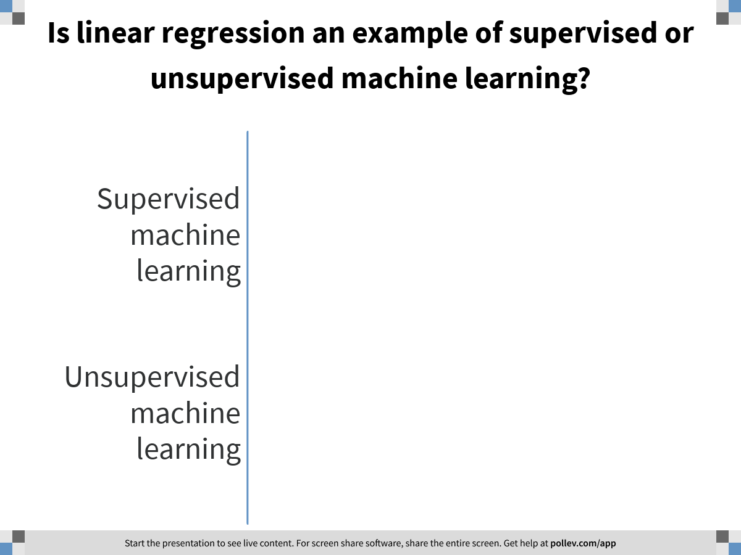
Notes:
Is linear regression an example of supervised or unsupervised machine learning?
https://www.polleverywhere.com/multiple_choice_polls/scpssb7iVyJiKiigtS0QS

Slide 30
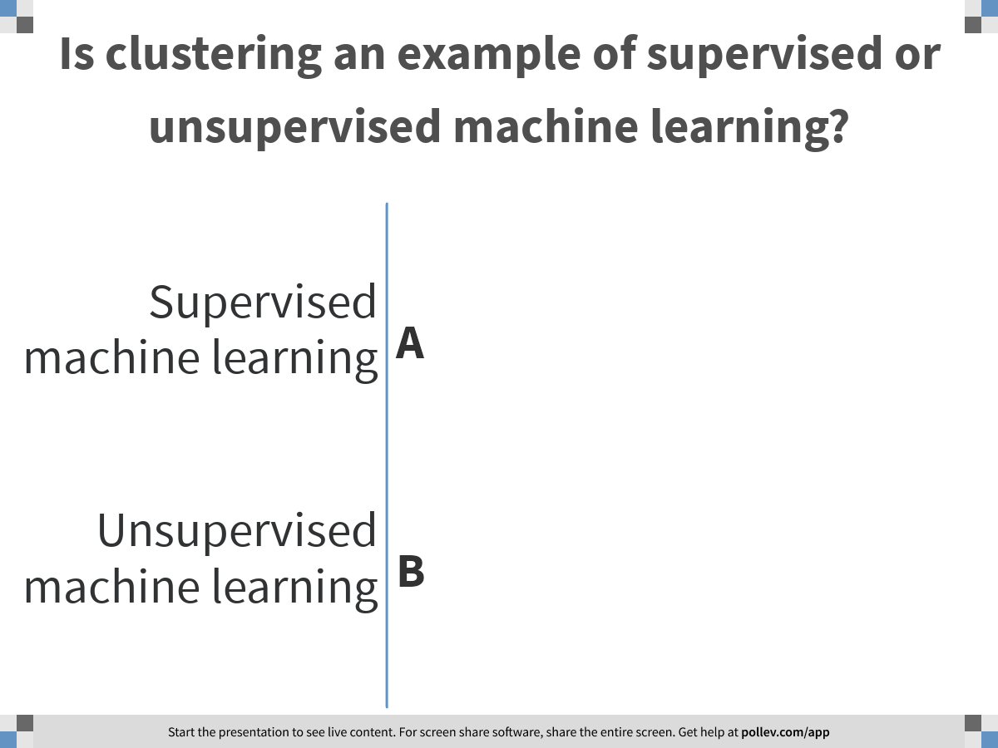
Notes:
Is clustering an example of supervised or unsupervised machine learning?
https://www.polleverywhere.com/multiple_choice_polls/aXbyOG4pwYRgnfVxxrpuf

Slide 31
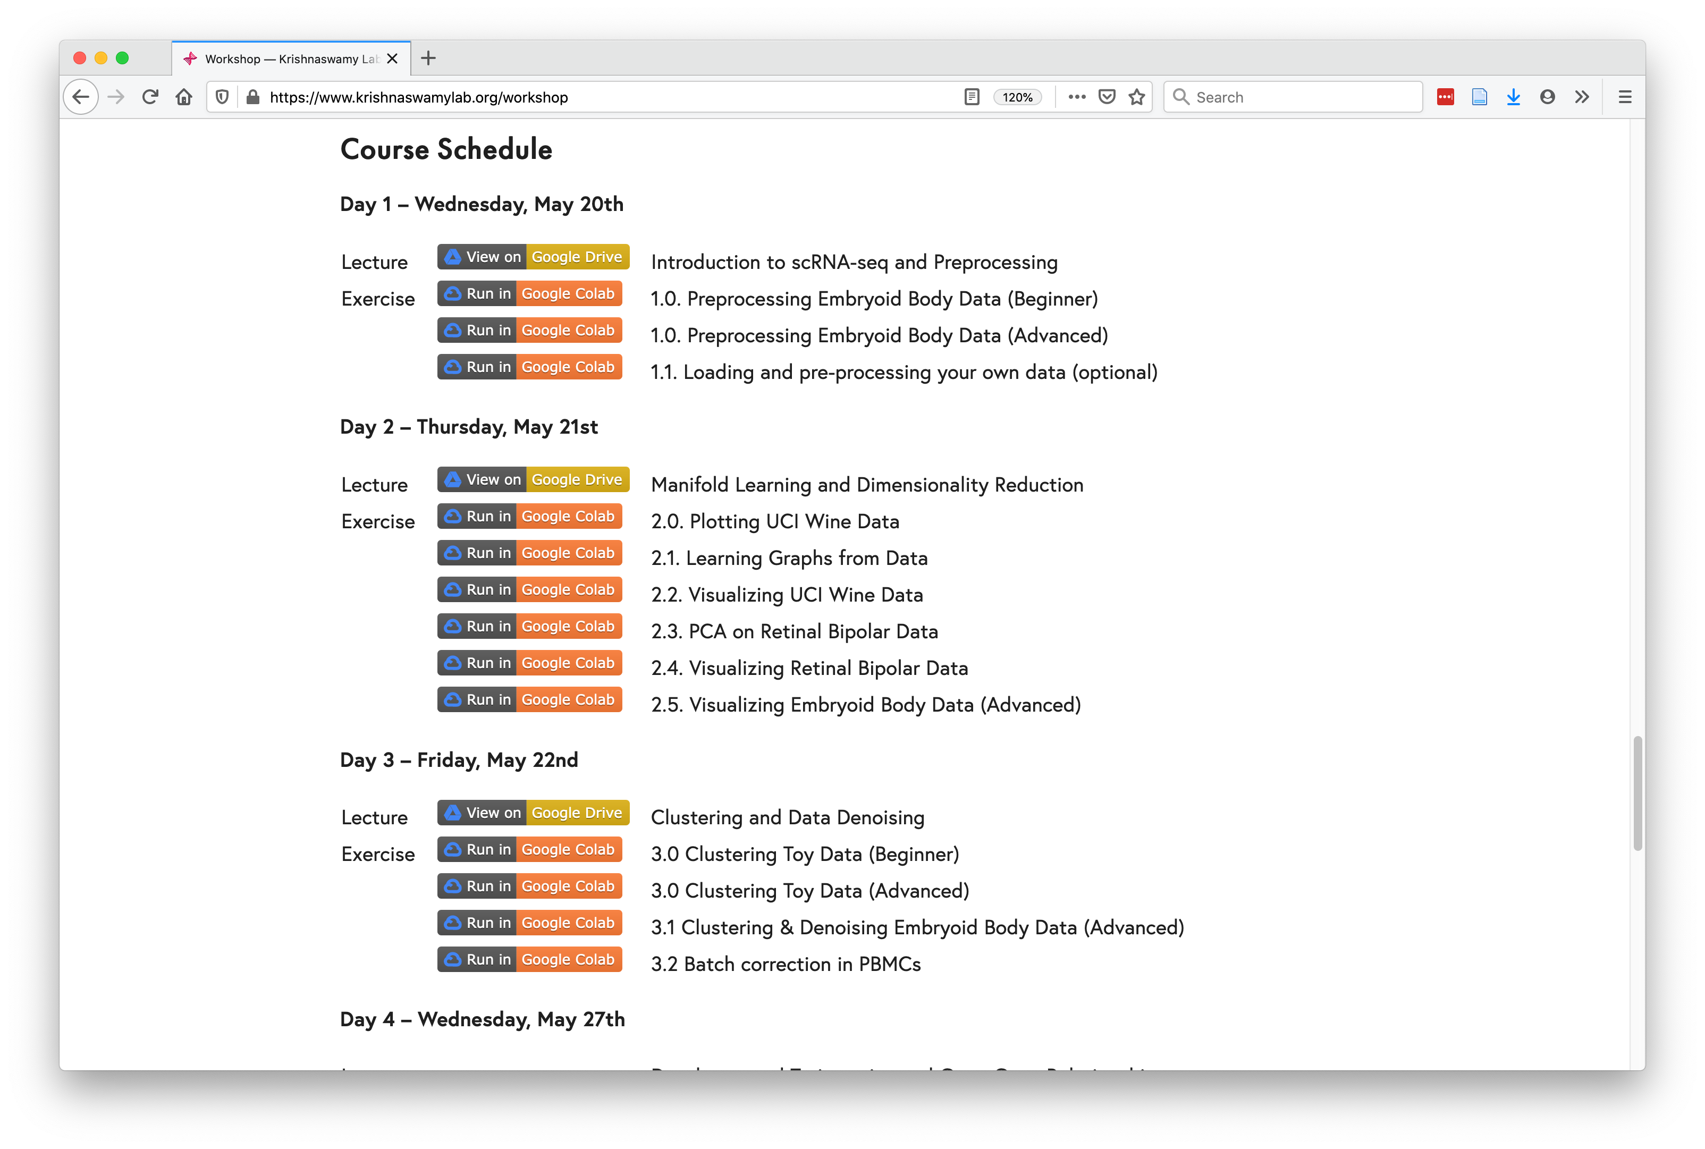
Course Schedule
https://www.krishnaswamylab.org/workshop

Slide 32

Why Python?

Slide 33
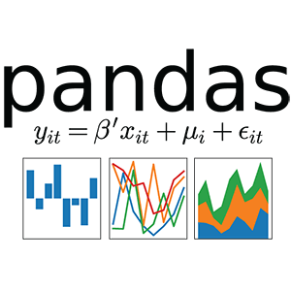

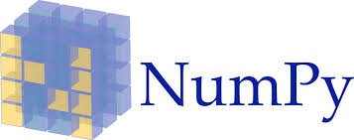




Why Python?
Tensorflow
Pytorch

Slide 34
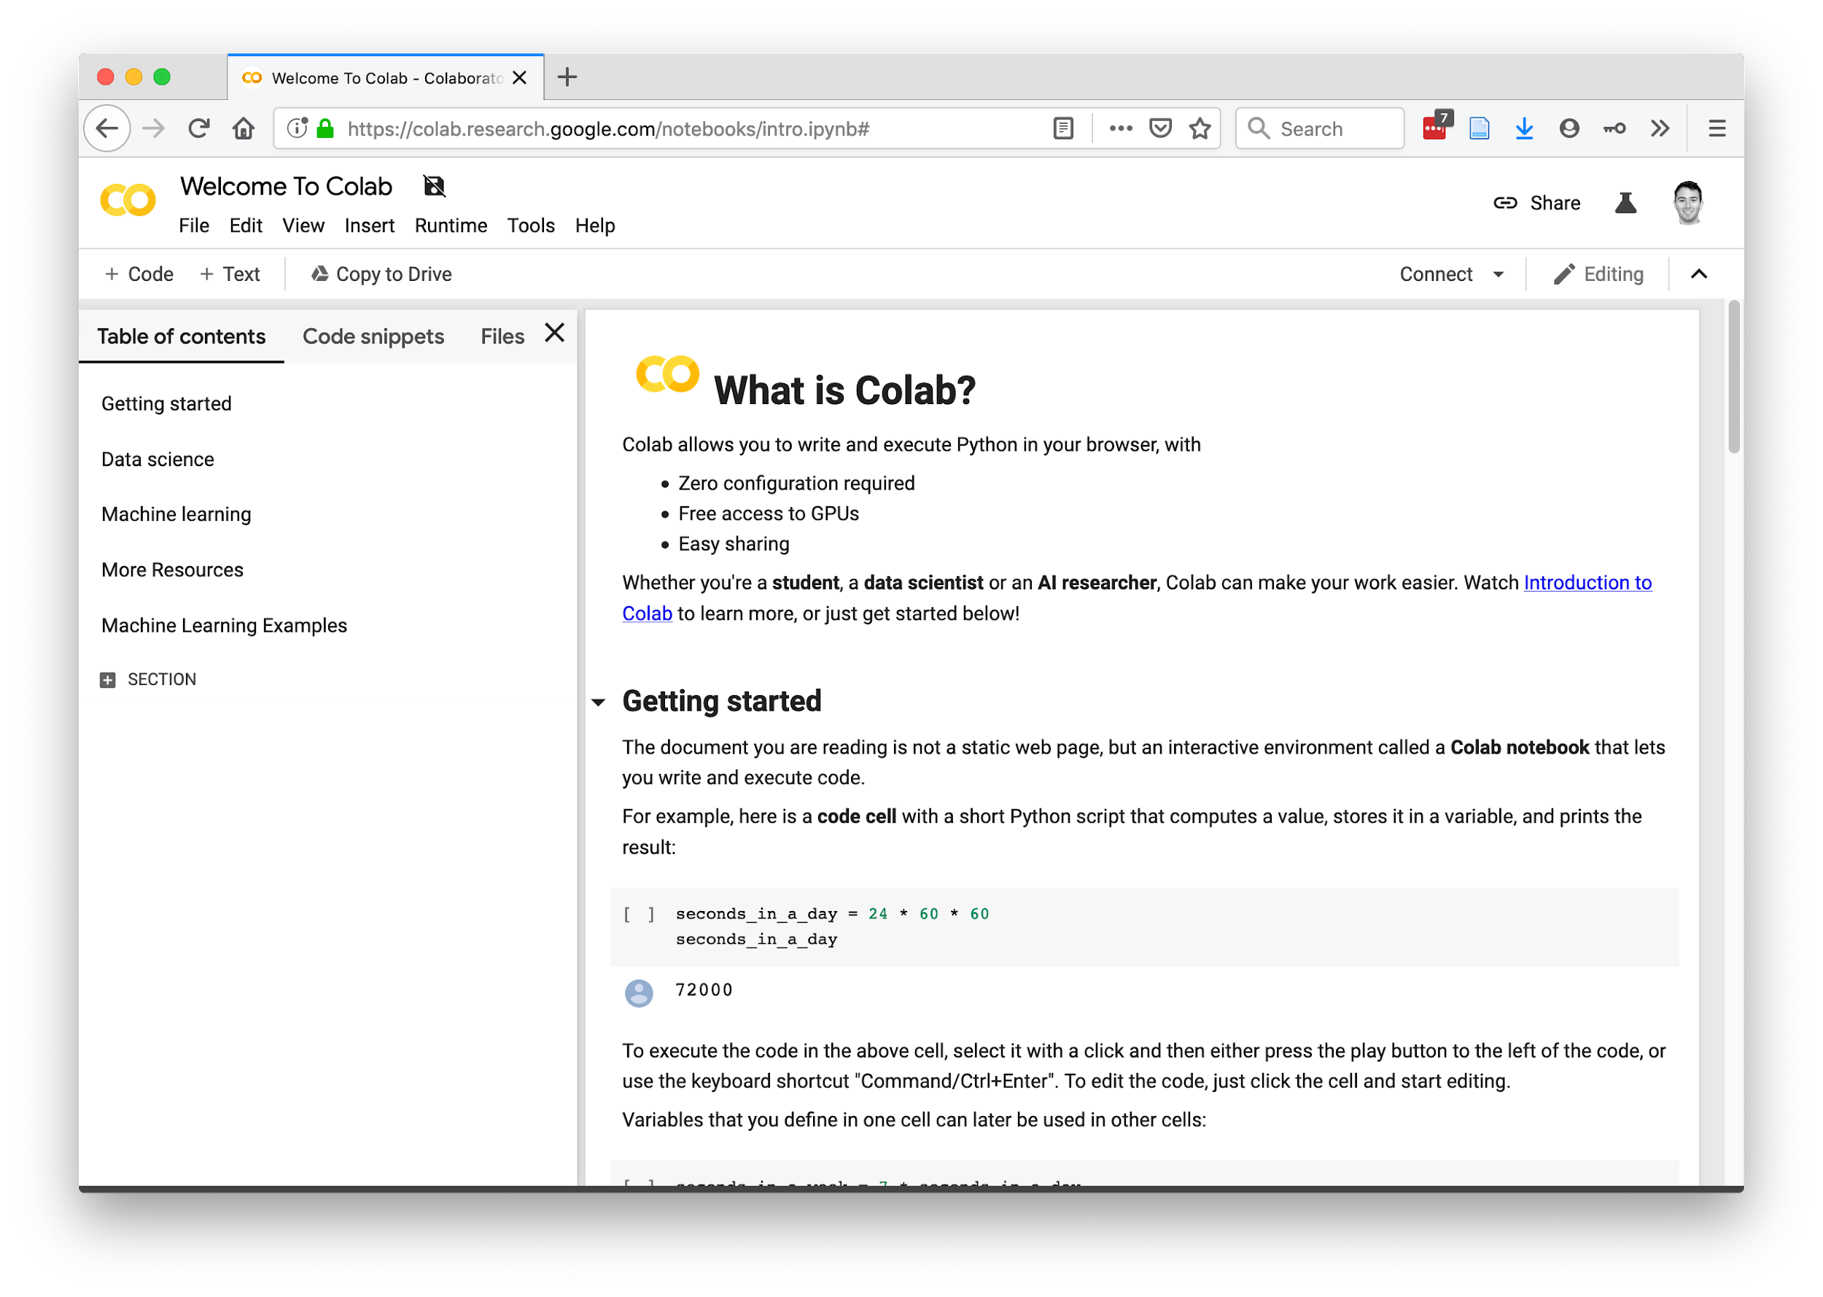
https://research.google.com/colaboratory/faq.html

Slide 35

Team programming
Noun project

Slide 36


vs.
Noun project

Slide 37


Slide 38
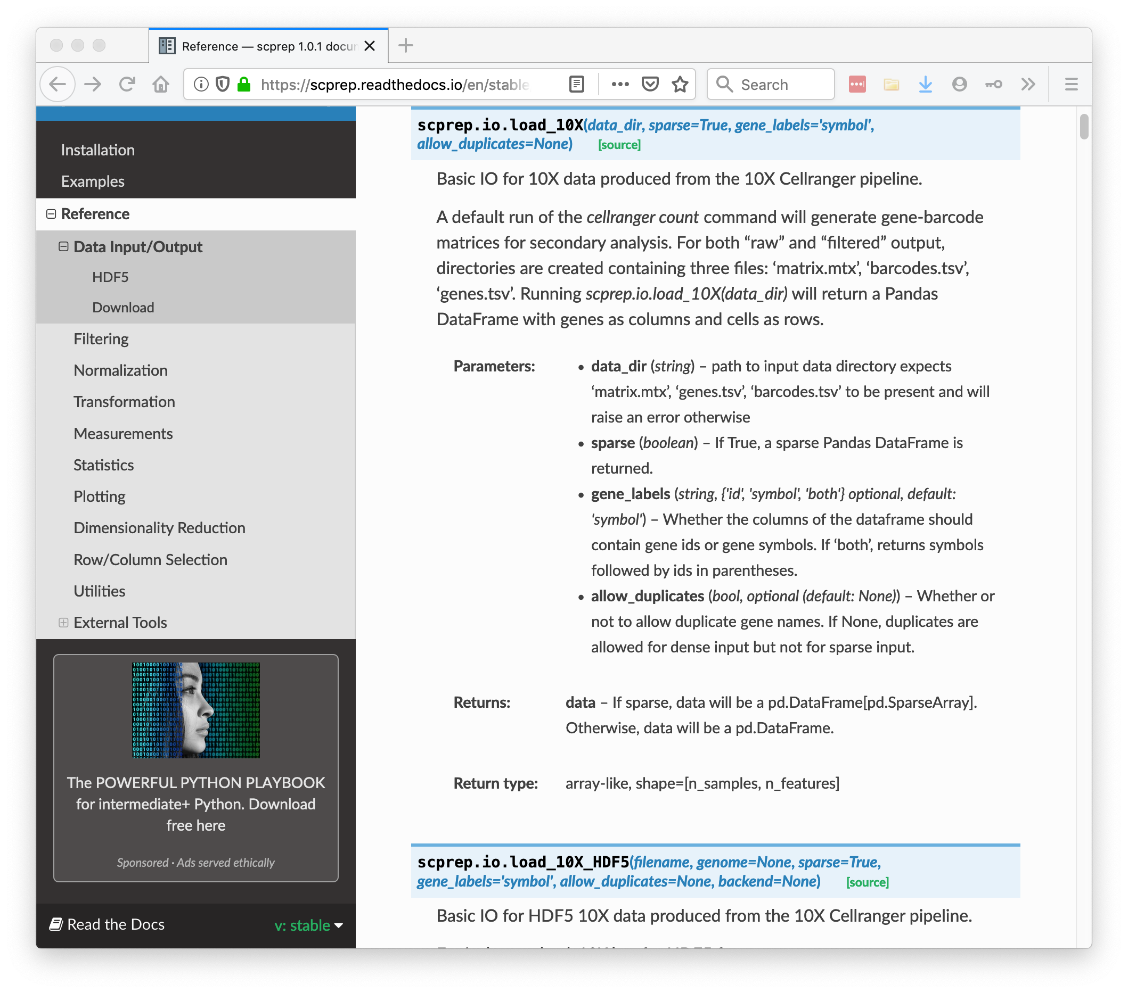

Slide 39

Bring-your-own-data workshop
#2020-workshop-byod-help
https://krishnaswamylab.org/get-help
Noun project

Slide 40
Data Matrices and Representations
Notes:
TA introduction
Talk about not teaching code (not a programming workshop)

Slide 41
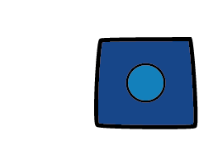
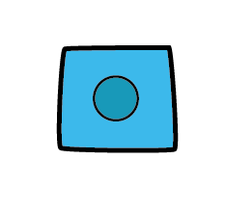
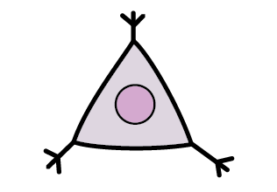
Single Cell Data
Each cell is a vector of measurements
e.g. Cell A = [40 0 20 18 5 0 …]
The whole data is a matrix with many observations (cells) and features (proteins, genes)
Features
(e.g. genes)
 | X | Y | Z
A | 10 | 20 | 70
B | 20 | 40 | 140
C | 20 | 0 | 80
Observations
(e.g. cells)

Slide 42
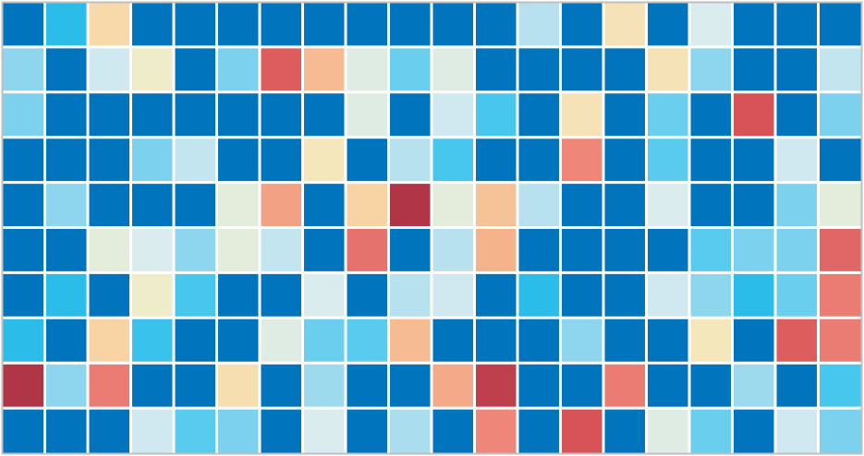
Single Cell Data
Samples
(1-100+)
Cells
(1K – 10M)
Genes / Proteins
(10-10K)

Slide 43
Our Data is a High-dimensional Matrix
variables
observations
gene1
gene2
gene3
Cell1
d11
d12
Cell2
d21
d22

Slide 44
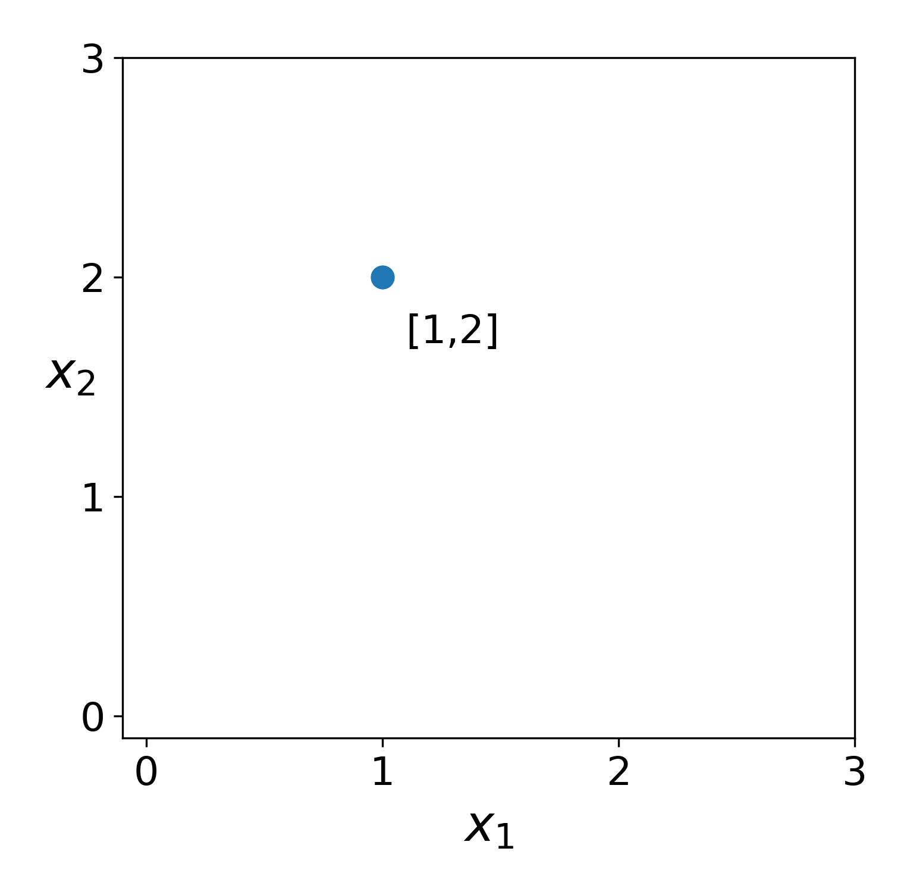
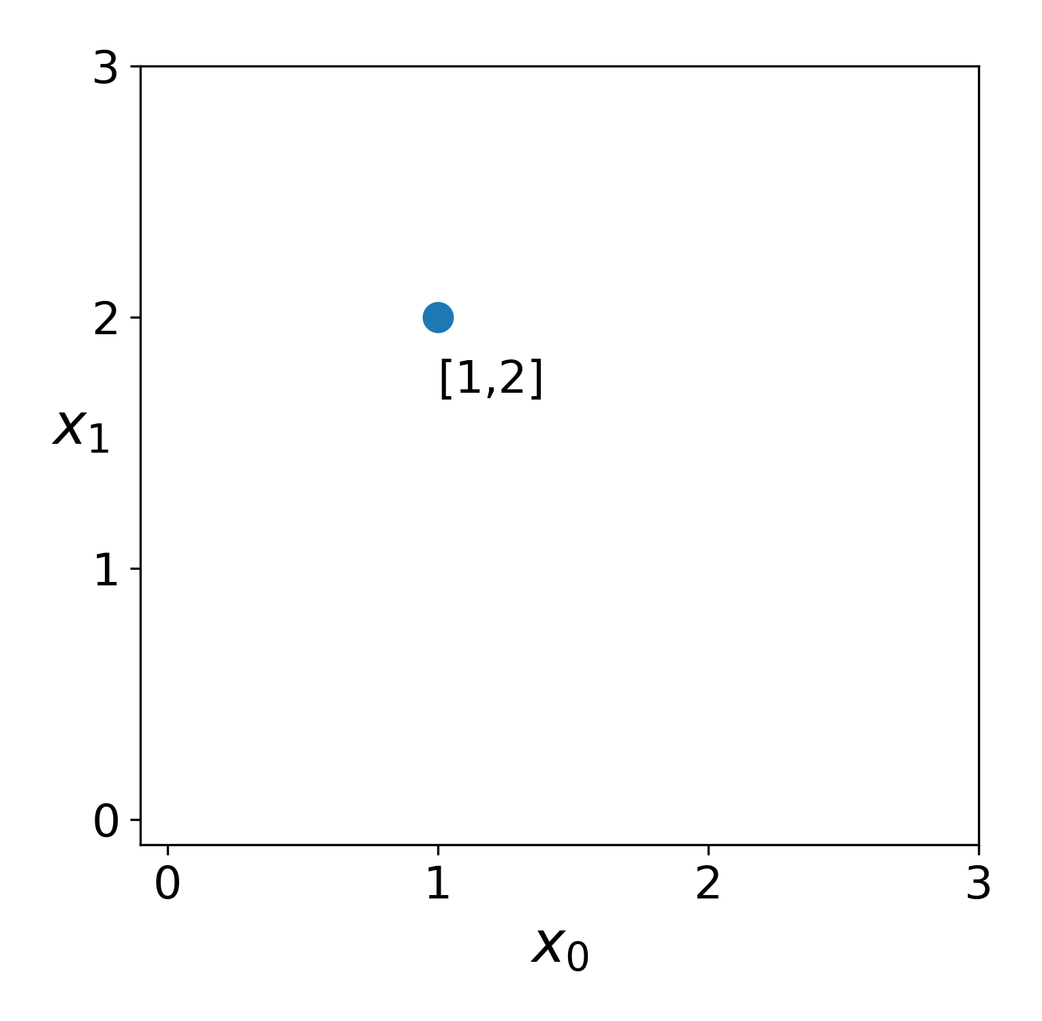
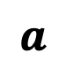
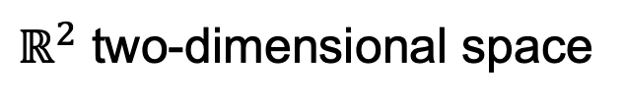
Spatial Representation of Data
$ℝ^{2}$ two-dimensional space
$$a$$

Slide 45
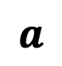
Spatial Representation of Data
$ℝ^{2}$ two-dimensional space
$$a$$

Slide 46
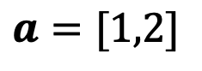
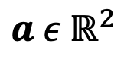
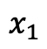
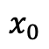
Spatial Representation of Data
$$a ε{ ℝ}^{2}$$
$ℝ^{2}$ two-dimensional space
$$a=[1,2]$$
$$x_{0}$$
$$x_{1}$$
$$a$$

Slide 47
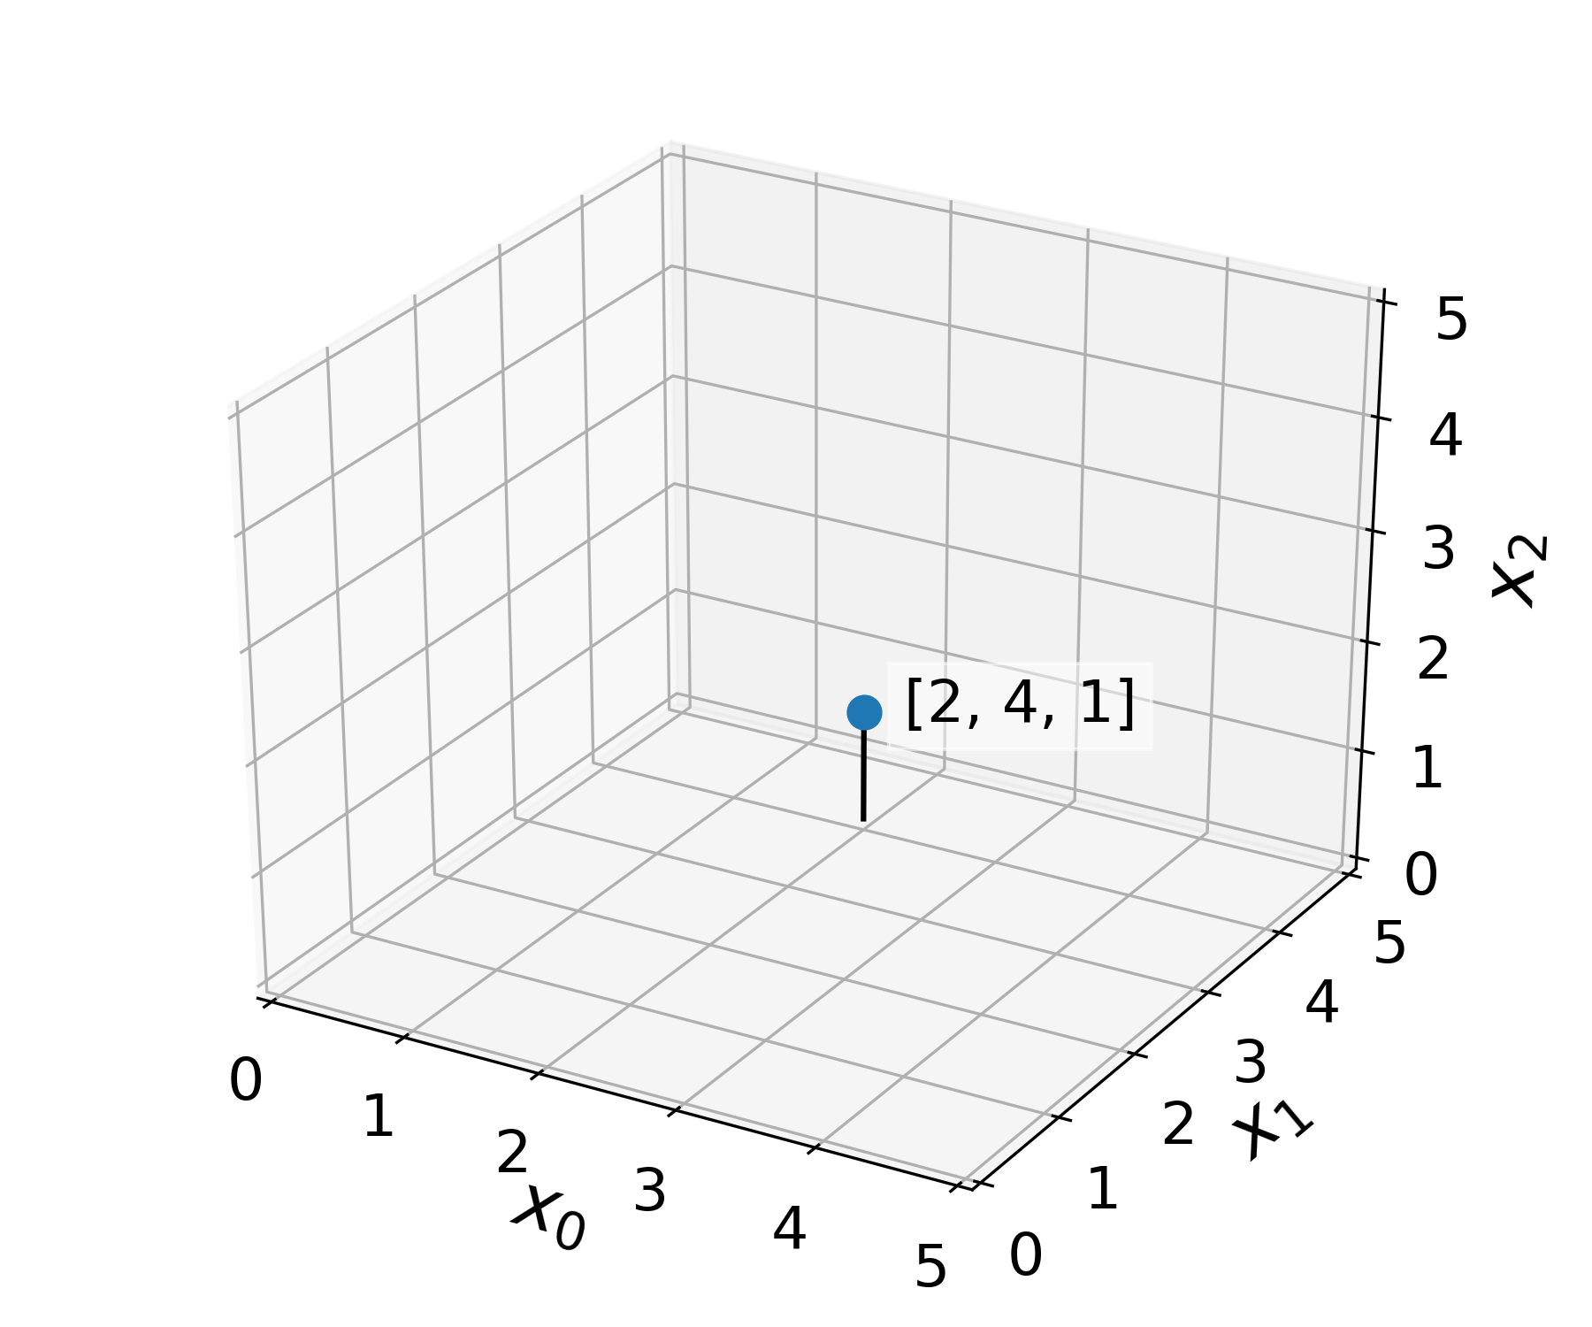









Features are dimensions
$$a ε{ ℝ}^{2}$$
$ℝ^{3}$ three-dimensional space
$$a=[1,2]$$
$$x_{0}$$
$$x_{1}$$
$$b ε{ ℝ}^{3}$$
$$b=[2,4,1]$$
$$b$$
$$x_{0}$$
$$x_{1}$$
$$x_{2}$$

Slide 48









Euclidean Distance between observations
$$a_{1}$$
$$d_{euclidean}\left(a_{0},a_{1}\right)= {\left\|a_{0}−a_{1}\right\|}_{2}^{2}$$
$$\text{2.24}$$
$$=\sqrt{{{(a}_{0,0} −a_{1,0})}^{2}+{{(a}_{0,1} −a_{1,1})}^{2}}$$
$$a_{0}$$
$$a_{2}$$
$$=\sqrt{{(1 −2)}^{2}+{(2 −4)}^{2}}$$
$$≈2\text{.24}$$

Slide 49





How far away is each point from $a_{0}?$
$$a_{1}$$
$$a_{0}$$
$$a_{2}$$

Slide 50





How far away is each point from $a_{0}?$
$$a_{1}$$
$$a_{0}$$
$$a_{2}$$

Slide 51







Manhattan Distance
Manhattan distance
$$a_{1}$$
$$d_{manhattan}\left(a_{0},a_{1}\right)=|a_{0,1} −a_{1,1}|$$
$$={|a}_{0,0} −a_{1,0}|+|a_{0,1} −a_{1,1}|$$
$$a_{0}$$
$$a_{2}$$
$$=|1 −2|+|2−4|$$
$$=3$$

Slide 52





How far away is each point from $a_{0}?$
$$a_{1}$$
$$a_{1}$$
$$a_{2}$$
$$a_{2}$$
$$a_{0}$$
$$a_{0}$$

Slide 53
Distances
There are many ways to measure distance
Hamming, Euclidean, Cosine
Distances are functions that take two points and return a real number that is positive or 0
Distances can be any function that is:
Symmetric: dist(a → b) = dist(b → a)
Non-negative: dist(a→b)>= 0
Follow triangle inequality: dist(a→c) <= dist(a→b) + dist(b→c)

Slide 54
Triangle Inequality

Slide 55






Representing Data as a Graph
Plot
Graph
$$a_{1}$$
$$a_{0}$$
$$a_{2}$$
$$G=(V,E)$$
$=V$ = vertices / nodes
$=E$ = edges

Slide 56




Fully connected Graph
 | $$a_{0}$$ | $$a_{1}$$ | $$a_{2}$$
$$a_{0}$$ | 0 | D(0,1) | D(0.2)
$$a_{1}$$ | D(0,1) | 0 | D(1,0)
$$a_{2}$$ | D(2,0) | D(2,1) | 0
$$a_{1}$$
D(0,1)
D(1,2)
$$a_{0}$$
$$a_{2}$$
D(0,2)
Distance matrix

Slide 57

Distance to Affinity via Kernels
Real-valued
Non-negative
Symmetric
Affinities correlations in this hidden hypothetical space

Slide 58

Affinities
 | $$a_{0}$$ | $$a_{1}$$ | $$a_{2}$$
$$a_{0}$$ | 0 | W(0,1) | W(0.2)
$$a_{1}$$ | W(0,1) | 0 | W(1,0)
$$a_{2}$$ | W(2,0) | W(2,1) | 0
$$a_{1}$$
W(0,1)
W(1,2)
$$a_{0}$$
$$a_{2}$$
W(0,2)
Affinity or Adjacency Matrix

Slide 59


Nearest Neighbors Graph
Data
Nearest Neighbor Graph
Edge
Notes:
Remove color from swiss roll then Add color

Slide 60


Swiss Roll
Distance Matrix
Notes:
Point out that A2 would be “sort of close” in Euclidean space

Slide 61

Kernel functions measure “similarity” or “affinity” on a graph

Slide 62



Affinity is the inverse of distance + locality
$$Affinity_{i,j}=s_{i,j}=exp\left(−\frac{dist{\left(x_{i}, x_{j}\right)}^{2}}{2σ^{2}}\right)$$

Slide 63

Why Represent Data as a Graph?
Graphs can be easy to cluster---look for a minimal
way of “cutting edges” to form groups
Graphs avoid needing to operate in high dimensions
they can just be represented as list of edges

Slide 64
Why Represent Data as a Graph?
Paths through data graphs can
represent progression trajectories

Slide 65





And much more to come!!

Slide 66
Preprocessing single-cell data
Notes:
TA introduction
Talk about not teaching code (not a programming workshop)

Slide 67

https://doi.org/10.15252/msb.20188746

Slide 68
Standard Single-Cell RNA-seq Workflow
Sequencing and read mapping
Quality control and filtering
Normalization
Data Correction
Add animation

Slide 69
Standard Single-Cell RNA-seq Workflow
Sequencing and read mapping
Quality control and filtering
Normalization
Data Correction
Dimensionality reduction and visualization
Add animation

Slide 70
Standard Single-Cell RNA-seq Workflow
Sequencing and read mapping
Quality control and filtering
Normalization
Data Correction
Dimensionality reduction and visualization
Downstream analysis
Clustering
Trajectory inference
Add animation

Slide 71
Standard Single-Cell RNA-seq Workflow
Sequencing and read mapping
Quality control and filtering
Normalization
Data Correction
Dimensionality reduction and visualization
Downstream analysis
Clustering
Trajectory inference
Differential expression
Add animation

Slide 72
Standard Single-Cell RNA-seq Workflow
Sequencing and read mapping
Quality control and filtering
Normalization
Data Correction
Dimensionality reduction and visualization
Downstream analysis
Clustering
Trajectory inference
Differential expression
Comparison of multiple conditions

Slide 73

Step 1 - Sequencing & read mapping
Building Counts Matrix → QC & Filtering → Normalization → Visualization → Analysis

Slide 74



Step 2 – Quality control and filtering
Dying cells
Multiplets
Empty Droplets
E.g.
low count depth
few detected genes
high fraction of mitochondrial counts
Building Counts Matrix → QC & Filtering → Normalization → Visualization → Analysis
Bad cells can be:
Dying cells,
Cells whose membranes are broken
Doublets
cytoplasmic mRNA has leaked out through a broken membrane
Unexpectedly high counts and a large number of detected genes means…?

Slide 75

Notes:
What could we look at to discriminate between dying cells, multiplets, or empty droplets and healthy single cells?
https://www.polleverywhere.com/discourses/UcO5ucV3uD4x4jbDv1PGc

Slide 76

Step 2 – Quality control and filtering
Building Counts Matrix → QC & Filtering → Normalization → Visualization → Analysis
Notes:
(A) Histograms of count depth per cell. The smaller histogram is zoomed‐in on count depths below 4,000. A threshold is applied here at 1,500 based on the peak detected at around 1,200 counts. (B) Histogram of the number of genes detected per cell. A small noise peak is visible at approx. 400 genes. These cells are filtered out using the depicted threshold (red line) at 700 genes. (C) Count depth distribution from high to low count depths. This visualization is related to the log–log plot shown in Cell Ranger outputs that is used to filter out empty droplets. It shows an “elbow” where count depths start to decrease rapidly around 1,500 counts. (D) Number of genes versus the count depth coloured by the fraction of mitochondrial reads. Mitochondrial read fractions are only high in particularly low count cells with few detected genes. These cells are filtered out by our count and gene number thresholds. Jointly visualizing the count and gene thresholds shows the joint filtering effect, indicating that a lower gene threshold may have sufficed. [Correction added on 5 July 2019, after first online publication: the x‐axis label in panel B was corrected from “Count depth” to “Number of genes”.]

Slide 77

Step 2 – Quality control and filtering
Building Counts Matrix → QC & Filtering → Normalization → Visualization → Analysis
Notes:
(A) Histograms of count depth per cell. The smaller histogram is zoomed‐in on count depths below 4,000. A threshold is applied here at 1,500 based on the peak detected at around 1,200 counts. (B) Histogram of the number of genes detected per cell. A small noise peak is visible at approx. 400 genes. These cells are filtered out using the depicted threshold (red line) at 700 genes. (C) Count depth distribution from high to low count depths. This visualization is related to the log–log plot shown in Cell Ranger outputs that is used to filter out empty droplets. It shows an “elbow” where count depths start to decrease rapidly around 1,500 counts. (D) Number of genes versus the count depth coloured by the fraction of mitochondrial reads. Mitochondrial read fractions are only high in particularly low count cells with few detected genes. These cells are filtered out by our count and gene number thresholds. Jointly visualizing the count and gene thresholds shows the joint filtering effect, indicating that a lower gene threshold may have sufficed. [Correction added on 5 July 2019, after first online publication: the x‐axis label in panel B was corrected from “Count depth” to “Number of genes”.]

Slide 78

Step 2 – Quality control and filtering
Building Counts Matrix → QC & Filtering → Normalization → Visualization → Analysis
Notes:
(A) Histograms of count depth per cell. The smaller histogram is zoomed‐in on count depths below 4,000. A threshold is applied here at 1,500 based on the peak detected at around 1,200 counts. (B) Histogram of the number of genes detected per cell. A small noise peak is visible at approx. 400 genes. These cells are filtered out using the depicted threshold (red line) at 700 genes. (C) Count depth distribution from high to low count depths. This visualization is related to the log–log plot shown in Cell Ranger outputs that is used to filter out empty droplets. It shows an “elbow” where count depths start to decrease rapidly around 1,500 counts. (D) Number of genes versus the count depth coloured by the fraction of mitochondrial reads. Mitochondrial read fractions are only high in particularly low count cells with few detected genes. These cells are filtered out by our count and gene number thresholds. Jointly visualizing the count and gene thresholds shows the joint filtering effect, indicating that a lower gene threshold may have sufficed. [Correction added on 5 July 2019, after first online publication: the x‐axis label in panel B was corrected from “Count depth” to “Number of genes”.]

Slide 79

Step 2 – Quality control and filtering
Building Counts Matrix → QC & Filtering → Normalization → Visualization → Analysis
Notes:
(A) Histograms of count depth per cell. The smaller histogram is zoomed‐in on count depths below 4,000. A threshold is applied here at 1,500 based on the peak detected at around 1,200 counts. (B) Histogram of the number of genes detected per cell. A small noise peak is visible at approx. 400 genes. These cells are filtered out using the depicted threshold (red line) at 700 genes. (C) Count depth distribution from high to low count depths. This visualization is related to the log–log plot shown in Cell Ranger outputs that is used to filter out empty droplets. It shows an “elbow” where count depths start to decrease rapidly around 1,500 counts. (D) Number of genes versus the count depth coloured by the fraction of mitochondrial reads. Mitochondrial read fractions are only high in particularly low count cells with few detected genes. These cells are filtered out by our count and gene number thresholds. Jointly visualizing the count and gene thresholds shows the joint filtering effect, indicating that a lower gene threshold may have sufficed. [Correction added on 5 July 2019, after first online publication: the x‐axis label in panel B was corrected from “Count depth” to “Number of genes”.]

Slide 80
Step 3 - Normalization
10% Capture Efficiency
20% CE
20% CE
Library size normalization (what we use)
Divide each cell by the sum of all counts (row-sum)
Multiply by some scalar (e.g. 10,000)
assumes that all cells in the dataset initially contained an equal number of mRNA molecules and count depth differences arise only due to sampling
Scran
size factors are estimated based on a linear regression over genes after cells are pooled
limits variability to fewer than 50% of genes being differentially expressed between cells
Many claims of superior performance by Leuken and Theis
Non-linear methods
Negative binomial regression (next week!)
Gene | Cell A
X | 10
Y | 20
Z | 70
Gene | Cell B
X | 20
Y | 40
Z | 140
Gene | Cell C
X | 20
Y | 0
Z | 80
If we only have gene expression, how can we determine which cells are similar?
Add animation
Building Counts Matrix → QC & Filtering → Normalization → Visualization → Analysis

Slide 81
Step 3 - Normalization
10% Capture Efficiency
20% CE
20% CE
Library size normalization (what we use)
Divide each cell by the sum of all counts (row-sum)
Multiply by some scalar (e.g. 10,000)
assumes that all cells in the dataset initially contained an equal number of mRNA molecules and count depth differences arise only due to sampling
Scran
size factors are estimated based on a linear regression over genes after cells are pooled
limits variability to fewer than 50% of genes being differentially expressed between cells
Many claims of superior performance by Leuken and Theis
Non-linear methods
Negative binomial regression (next week!)
Gene | Cell A
X | 10
Y | 20
Z | 70
Gene | Cell B
X | 20
Y | 40
Z | 140
Gene | Cell C
X | 20
Y | 0
Z | 80
Add animation
Building Counts Matrix → QC & Filtering → Normalization → Visualization → Analysis

Slide 82
Step 3 - Normalization
10% Capture Efficiency
20% CE
20% CE
Library size normalization (what we use)
Divide each cell by the sum of all counts (row-sum)
Multiply by some scalar (e.g. 10,000)
assumes that all cells in the dataset initially contained an equal number of mRNA molecules and count depth differences arise only due to sampling
Scran
size factors are estimated based on a linear regression over genes after cells are pooled
limits variability to fewer than 50% of genes being differentially expressed between cells
Many claims of superior performance by Leuken and Theis
Non-linear methods
Negative binomial regression (next week!)
Gene | Cell A
X | 10
Y | 20
Z | 70
Gene | Cell B
X | 20
Y | 40
Z | 140
Gene | Cell C
X | 20
Y | 0
Z | 80
Add animation
Building Counts Matrix → QC & Filtering → Normalization → Visualization → Analysis

Slide 83
Step 3 - Normalization
10% Capture Efficiency
20% CE
20% CE
Library size normalization (what we use)
Divide each cell by the sum of all counts (row-sum)
Multiply by some scalar (e.g. 10,000)
assumes that all cells in the dataset initially contained an equal number of mRNA molecules and count depth differences arise only due to sampling
Scran
size factors are estimated based on a linear regression over genes after cells are pooled
limits variability to fewer than 50% of genes being differentially expressed between cells
Many claims of superior performance by Leuken and Theis
Non-linear methods
Negative binomial regression (next week!)
Gene | Cell A
X | 10
Y | 20
Z | 70
Gene | Cell B
X | 20
Y | 40
Z | 140
Gene | Cell C
X | 20
Y | 0
Z | 80
Add animation
Building Counts Matrix → QC & Filtering → Normalization → Visualization → Analysis

Slide 84
Step 3 - Normalization
Raw counts
 | X | Y | Z
A | 10 | 20 | 70
B | 20 | 40 | 140
C | 20 | 0 | 80
Library size normalization (what we use)
Divide each cell by the sum of all counts (row-sum)
Multiply by some scalar (e.g. 10,000)
assumes that all cells in the dataset initially contained an equal number of mRNA molecules and count depth differences arise only due to sampling
Scran
size factors are estimated based on a linear regression over genes after cells are pooled
limits variability to fewer than 50% of genes being differentially expressed between cells
Many claims of superior performance by Leuken and Theis
Non-linear methods
Negative binomial regression (next week!)

Slide 85
Step 3 - Normalization
Raw counts
 | X | Y | Z
A | 10 | 20 | 70
B | 20 | 40 | 140
C | 20 | 0 | 80
Library size normalization (what we use)
Divide each cell by the sum of all counts (row-sum)
Multiply by some scalar (e.g. 10,000)
assumes that all cells in the dataset initially contained an equal number of mRNA molecules and count depth differences arise only due to sampling
Scran
size factors are estimated based on a linear regression over genes after cells are pooled
limits variability to fewer than 50% of genes being differentially expressed between cells
Many claims of superior performance by Leuken and Theis
Non-linear methods
Negative binomial regression (next week!)
dist(A,B) = $\sqrt{{\left(x_{A}−x_{B}\right)}^{2}+{\left(y_{a}−y_{b}\right)}^{2}+{\left(z_{a}−z_{b}\right)}^{2}}$

Slide 86
Step 3 - Normalization
Raw counts
 | X | Y | Z
A | 10 | 20 | 70
B | 20 | 40 | 140
C | 20 | 0 | 80
Pairwise distances
dist(A,B) = 71.4
Library size normalization (what we use)
Divide each cell by the sum of all counts (row-sum)
Multiply by some scalar (e.g. 10,000)
assumes that all cells in the dataset initially contained an equal number of mRNA molecules and count depth differences arise only due to sampling
Scran
size factors are estimated based on a linear regression over genes after cells are pooled
limits variability to fewer than 50% of genes being differentially expressed between cells
Many claims of superior performance by Leuken and Theis
Non-linear methods
Negative binomial regression (next week!)
dist(A,B) = $\sqrt{{\left(x_{A}−x_{B}\right)}^{2}+{\left(y_{a}−y_{b}\right)}^{2}+{\left(z_{a}−z_{b}\right)}^{2}}$

Slide 87
Step 3 - Normalization
Raw counts
 | X | Y | Z
A | 10 | 20 | 70
B | 20 | 40 | 140
C | 20 | 0 | 80
Pairwise distances
dist(A,B) = 71.4
dist(A,C) = 24.5
dist(B,C) = 67.1
Library size normalization (what we use)
Divide each cell by the sum of all counts (row-sum)
Multiply by some scalar (e.g. 10,000)
assumes that all cells in the dataset initially contained an equal number of mRNA molecules and count depth differences arise only due to sampling
Scran
size factors are estimated based on a linear regression over genes after cells are pooled
limits variability to fewer than 50% of genes being differentially expressed between cells
Many claims of superior performance by Leuken and Theis
Non-linear methods
Negative binomial regression (next week!)
dist(A,B) = $\sqrt{{\left(x_{A}−x_{B}\right)}^{2}+{\left(y_{a}−y_{b}\right)}^{2}+{\left(z_{a}−z_{b}\right)}^{2}}$

Slide 88
Step 3 - Normalization
Raw counts
 | X | Y | Z
A | 10 | 20 | 70
B | 20 | 40 | 140
C | 20 | 0 | 80
Library
Size
Pairwise distances
100
200
100
dist(A,B) = 71.4
dist(A,C) = 24.5
dist(B,C) = 67.1
Library size normalization (what we use)
Divide each cell by the sum of all counts (row-sum)
Multiply by some scalar (e.g. 10,000)
assumes that all cells in the dataset initially contained an equal number of mRNA molecules and count depth differences arise only due to sampling
Scran
size factors are estimated based on a linear regression over genes after cells are pooled
limits variability to fewer than 50% of genes being differentially expressed between cells
Many claims of superior performance by Leuken and Theis
Non-linear methods
Negative binomial regression (next week!)
dist(A,B) = $\sqrt{{\left(x_{A}−x_{B}\right)}^{2}+{\left(y_{a}−y_{b}\right)}^{2}+{\left(z_{a}−z_{b}\right)}^{2}}$

Slide 89
Step 3 - Normalization
Normalized counts
 | X | Y | Z
A | 0.1 | 0.2 | 0.7
B | 0.1 | 0.2 | 0.7
C | 0.2 | 0 | 0.8
Library
Size
Pairwise distances
100
200
100
dist(A,B) = 71.4
dist(A,C) = 24.5
dist(B,C) = 67.1
Library size normalization (what we use)
Divide each cell by the sum of all counts (row-sum)
Multiply by some scalar (e.g. 10,000)
assumes that all cells in the dataset initially contained an equal number of mRNA molecules and count depth differences arise only due to sampling
Scran
size factors are estimated based on a linear regression over genes after cells are pooled
limits variability to fewer than 50% of genes being differentially expressed between cells
Many claims of superior performance by Leuken and Theis
Non-linear methods
Negative binomial regression (next week!)
dist(A,B) = $\sqrt{{\left(x_{A}−x_{B}\right)}^{2}+{\left(y_{a}−y_{b}\right)}^{2}+{\left(z_{a}−z_{b}\right)}^{2}}$

Slide 90
Step 3 - Normalization
Normalized counts
 | X | Y | Z
A | 0.1 | 0.2 | 0.7
B | 0.1 | 0.2 | 0.7
C | 0.2 | 0 | 0.8
Library
Size
Pairwise distances
100
200
100
dist(A,B) = 0
dist(A,C) = 0.25
dist(B,C) = 0.25
Library size normalization (what we use)
Divide each cell by the sum of all counts (row-sum)
Multiply by some scalar (e.g. 10,000)
assumes that all cells in the dataset initially contained an equal number of mRNA molecules and count depth differences arise only due to sampling
Scran
size factors are estimated based on a linear regression over genes after cells are pooled
limits variability to fewer than 50% of genes being differentially expressed between cells
Many claims of superior performance by Leuken and Theis
Non-linear methods
Negative binomial regression (next week!)
dist(A,B) = $\sqrt{{\left(x_{A}−x_{B}\right)}^{2}+{\left(y_{a}−y_{b}\right)}^{2}+{\left(z_{a}−z_{b}\right)}^{2}}$

Slide 91

More complex normalization approaches exist
https://doi.org/10.1186/s13059-016-0947-7

Slide 92
Step 3.5 – Transformation / Scaling
Normalized counts
 | X | Y | Z
A | 0.1 | 0.2 | 0.7
B | 0.1 | 0.2 | 0.7
C | 0.2 | 0 | 0.8
Library size normalization (what we use)
Divide each cell by the sum of all counts (row-sum)
Multiply by some scalar (e.g. 10,000)
assumes that all cells in the dataset initially contained an equal number of mRNA molecules and count depth differences arise only due to sampling
Scran
size factors are estimated based on a linear regression over genes after cells are pooled
limits variability to fewer than 50% of genes being differentially expressed between cells
Many claims of superior performance by Leuken and Theis
Non-linear methods
Negative binomial regression (next week!)
What if this is a housekeeping gene?
What if this is a transcription factor?
Building Counts Matrix → QC & Filtering → Normalization → Visualization → Analysis

Slide 93
Step 3.5 – Transformation / Scaling
sqrt(normalized counts)
 | X | Y | Z
A | 0.32 | 0.45 | 0.84
B | 0.32 | 0.45 | 0.89
C | 0.2 | 0 | 0.89
Library size normalization (what we use)
Divide each cell by the sum of all counts (row-sum)
Multiply by some scalar (e.g. 10,000)
assumes that all cells in the dataset initially contained an equal number of mRNA molecules and count depth differences arise only due to sampling
Scran
size factors are estimated based on a linear regression over genes after cells are pooled
limits variability to fewer than 50% of genes being differentially expressed between cells
Many claims of superior performance by Leuken and Theis
Non-linear methods
Negative binomial regression (next week!)
What if this is a housekeeping gene?
What if this is a transcription factor?
Building Counts Matrix → QC & Filtering → Normalization → Visualization → Analysis

Slide 94

Notes:
What kind of transformations, other than square-root, could we apply to single cell data?
https://www.polleverywhere.com/discourses/RSvObGwo3r8r5cjggv9zW

Slide 95

Step 5 – Dimensionality reduction and visualization
Selecting highly variable genes (HVGs):
Calculate log10 mean expression and variance
Fit a loess curve
Standardize variance to mean 0 std 1
Take the top 2000 HVGs
Building Counts Matrix → QC & Filtering → Normalization → Visualization → Analysis
https://satijalab.org/seurat/v3.1/pbmc3k_tutorial.html

Slide 96
Standard Single-Cell RNA-seq Workflow
Sequencing and read mapping
Quality control and filtering
Normalization
Data Correction
Dimensionality reduction and visualization
Downstream analysis
Clustering
Trajectory inference
Differential expression
Comparison of multiple conditions

Slide 97

Notes:
What questions do you have about today's material?
https://www.polleverywhere.com/discourses/OwyeOZgCO1pghr2PFpmJz

Slide 98




Exercise!
Load, preprocess, and visualize a scRNAseq dataset generated from a time course of embryoid bodies

